Slide 1
SEABORN

Slide 2
What is Data Visualization in Seaborn?
Seaborn is a powerful Python library built on top of Matplotlib.
Used for making statistical graphics with ease.
Enhances the look of plots and supports complex visualizations.
Helps in understanding data patterns, trends, and outliers.

Slide 3
Diff
Feature | Matplotlib | Seaborn
Level | Low-level | High-level
Customization | Highly customizable, fine-grained control | Limited customization, sensible defaults
Code | More code required for basic plots | Less code required for statistical plots
Default Styles | Limited default styles, manual customization | Built-in themes and color palettes
Focus | General-purpose plotting, detailed control | Statistical plotting, exploratory data analysis
Data Handling | Can work with Pandas, but may require manipulation | Flexible with Pandas, less data manipulation

Slide 4
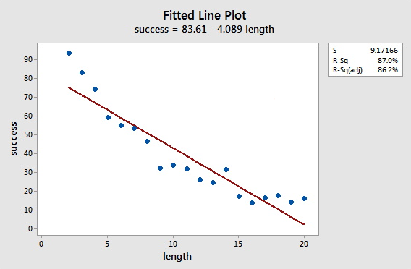
Seaborn Line Plot
Purpose: Visualize trends over time or ordered values.
Function: sns.lineplot()
Key Parameters:
x, y: Variables to plot.
data: Data source (e.g., DataFrame).
Use Case: Plotting temperature over days.
This Photo by Unknown Author is licensed under CC BY-NC

Slide 5
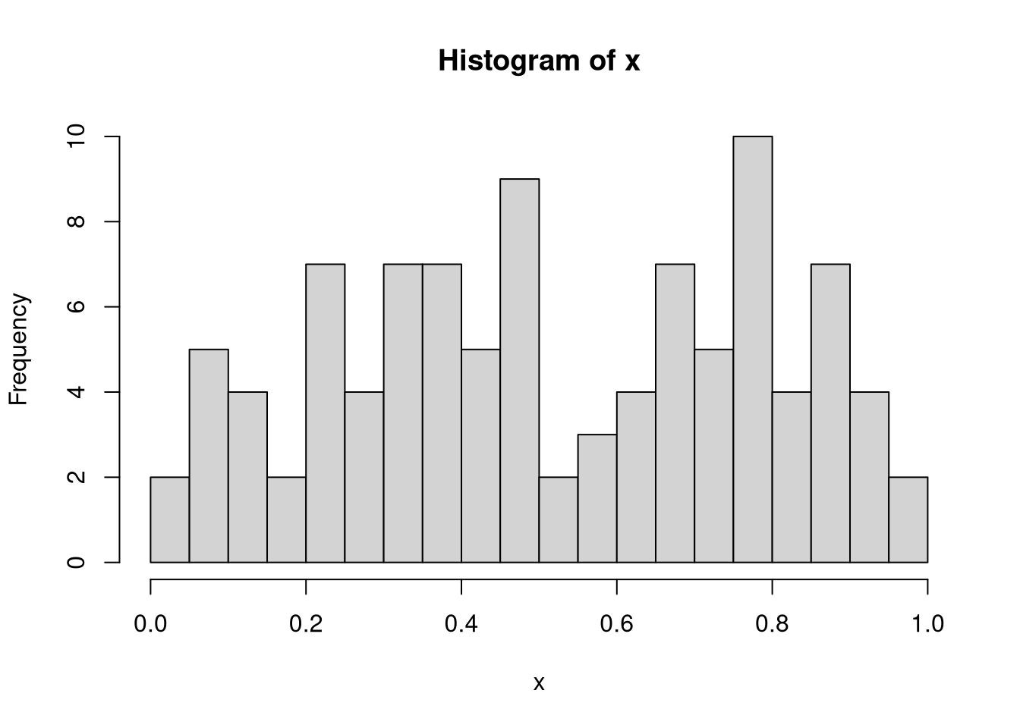
Seaborn Histogram Plot
Purpose: Show distribution of a single variable.
Function: sns.histplot()
Key Parameters:
bins: Number of intervals.
kde=True: To show density curve.
Use Case: Distribution of students' scores.

Slide 6
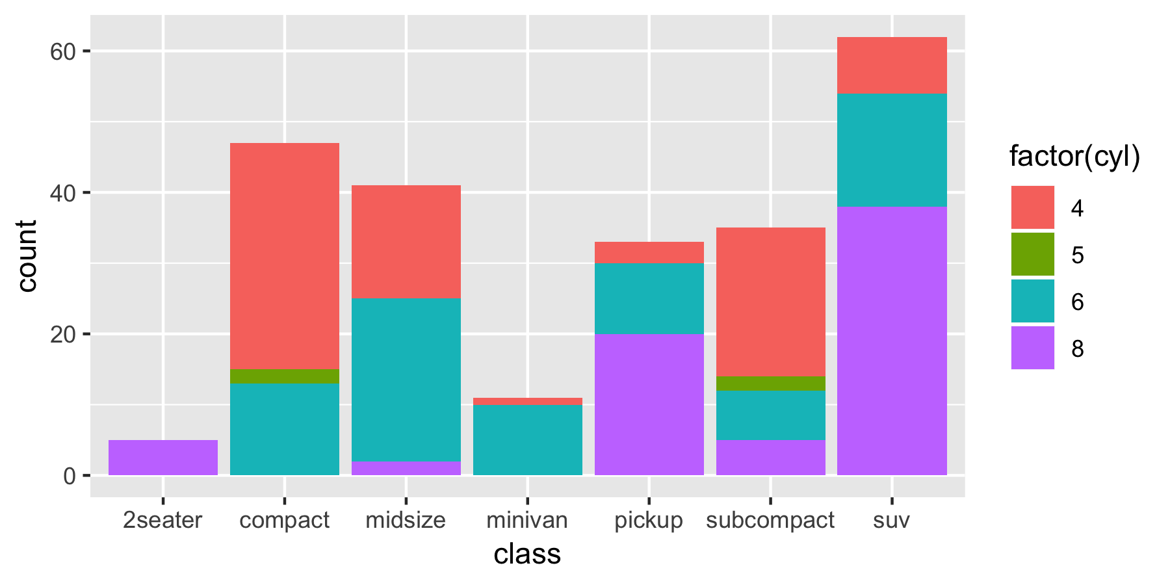
Seaborn Bar Plot
Purpose: Compare categorical data.
Function: sns.barplot()
Key Parameters:
x, y, data
hue: Grouping variable
Use Case: Average marks by class.
This Photo by Unknown Author is licensed under CC BY-SA

Slide 7
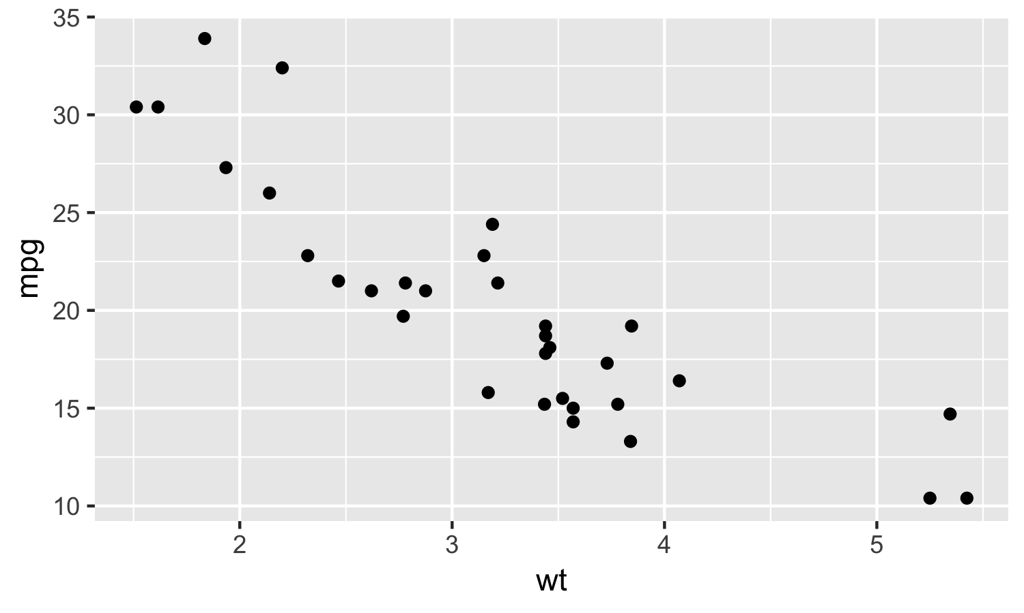
Seaborn Scatter Plot
Purpose: Show relationship between two numerical variables.
Function: sns.scatterplot()
Key Parameters:
x, y, hue, style, size
Use Case: Height vs weight.
This Photo by Unknown Author is licensed under CC BY-SA

Slide 8
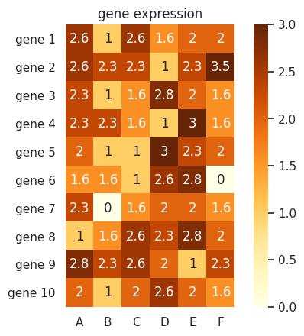
Seaborn Heatmap
Purpose: Show matrix-like data with color.
Function: sns.heatmap()
Key Parameters:
annot=True: Show numbers.
cmap: Color theme.
Use Case: Correlation matrix.
This Photo by Unknown Author is licensed under CC BY

Slide 9
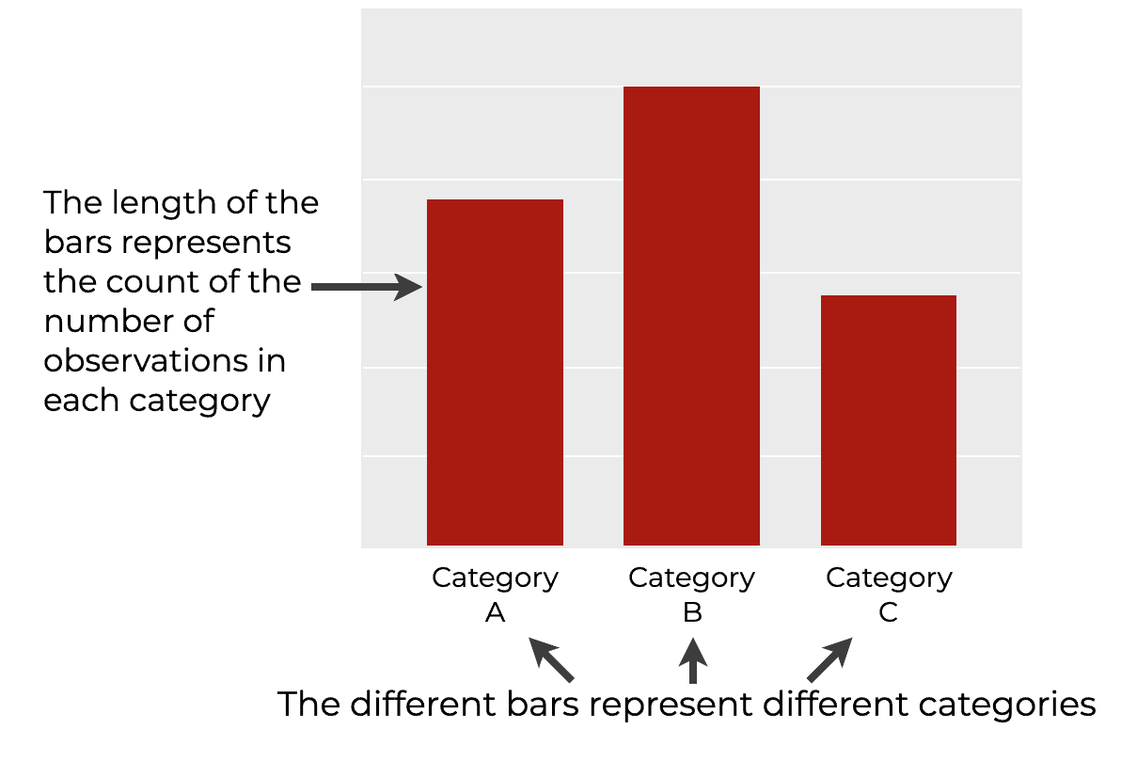
Seaborn Count Plot
Purpose: Count of occurrences in each category.
Function: sns.countplot()
Use Case: Number of students in each department.
This Photo by Unknown Author is licensed under CC BY-NC

Slide 10
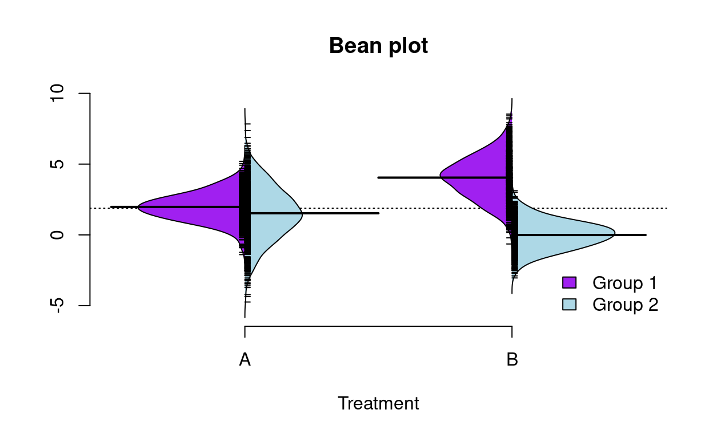
Seaborn Violin Plot
Purpose: Combine box plot and KDE.
Function: sns.violinplot()
Use Case: Distribution of scores across genders.
This Photo by Unknown Author is licensed under CC BY

Slide 11
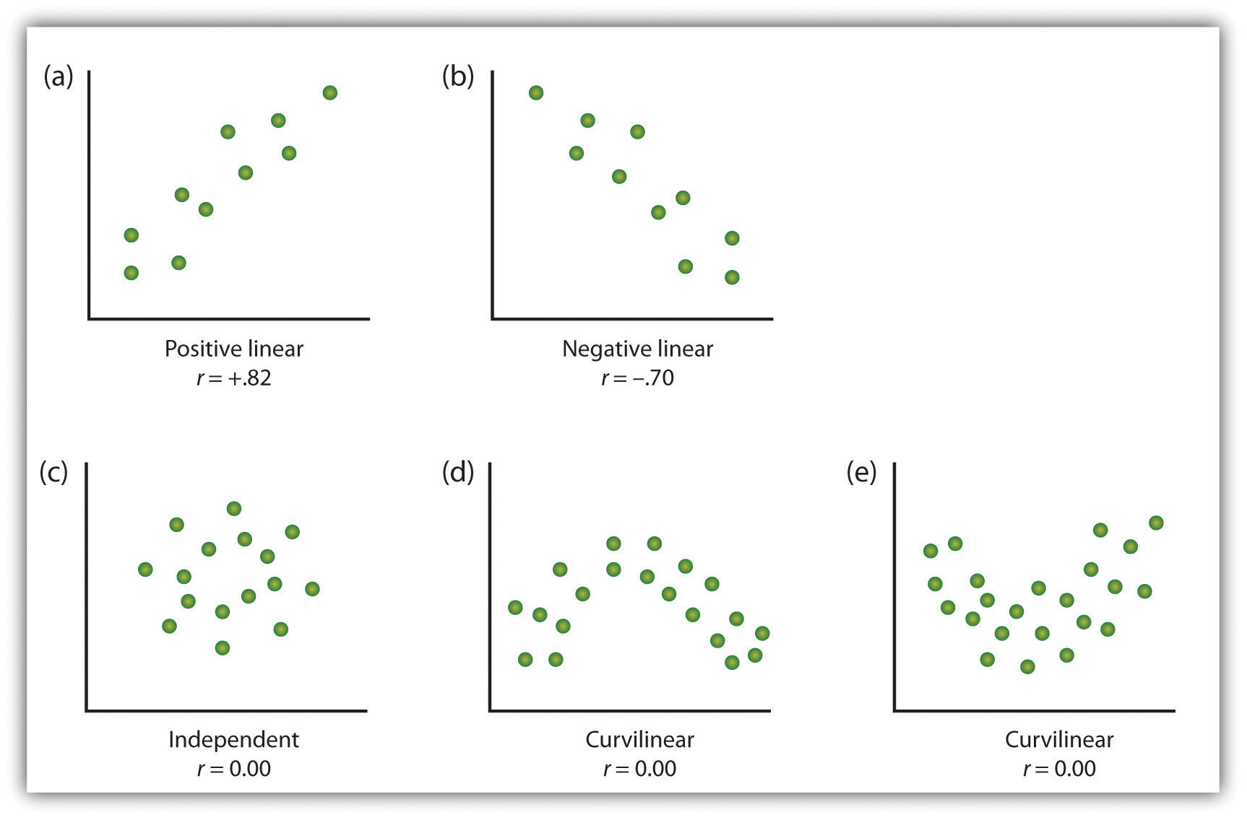
Seaborn Pair Plot
Purpose: Plot pairwise relationships in a dataset.
Function: sns.pairplot()
Use Case: Explore Iris dataset features.
This Photo by Unknown Author is licensed under CC BY-NC

Slide 12
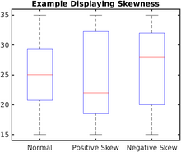
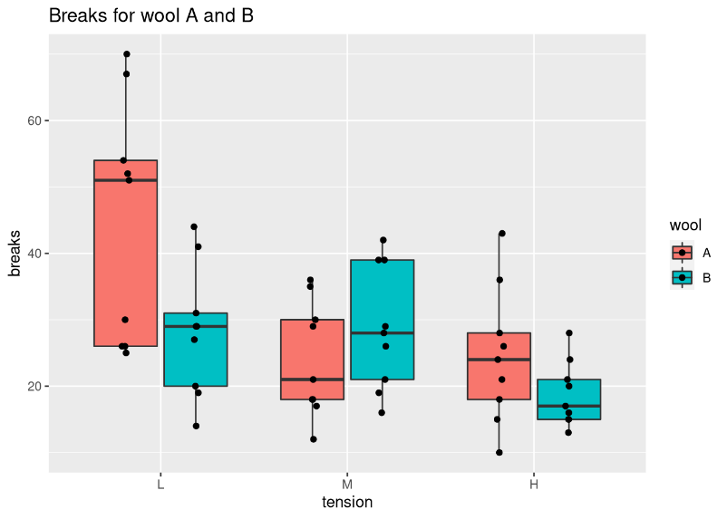
Seaborn Box Plot
Purpose: Show distribution and outliers.
Function: sns.boxplot()
Use Case: Salary distribution by role.
This Photo by Unknown Author is licensed under CC BY-SA

Slide 13
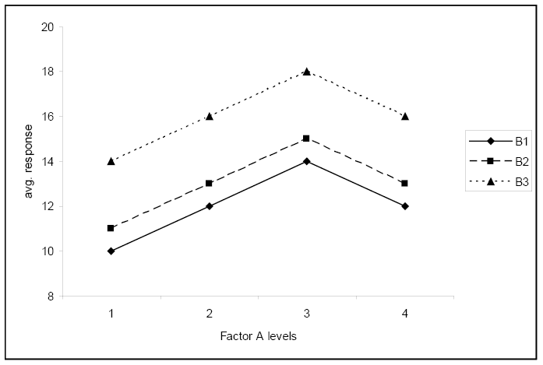
Seaborn Factor Plot (Note: Deprecated, use catplot)
Purpose: General categorical plot.
Function: sns.factorplot() (Now replaced by catplot)
Use Case: Useful when changing plot kind dynamically.
This Photo by Unknown Author is licensed under CC BY-SA-NC

Slide 14
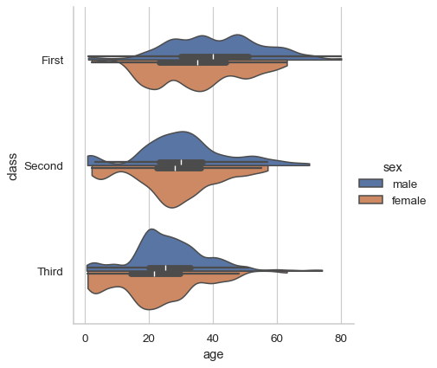
Seaborn Cat Plot
Purpose: High-level plot for categorical data.
Function: sns.catplot()
Use Case: Bar, strip, box plots in one

Slide 15
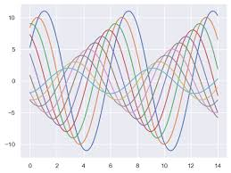
Seaborn Styling Plot
Purpose: Make plots visually appealing.
Functions:
sns.set_style(): Set themes (white, darkgrid, etc.)
sns.set_context(): Scale elements for presentation.
Use Case: Professional visual outputs.

Slide 16

THANK YOU

